Slide 1
10GBASE-T Coding and Modulation: 128-DSQ + LDPC

Slide 2
Abstract
128-DSQ+LDPC coding
Two variants
128-DSQ symbol mapping, soft-demapping
Performance result

Slide 3







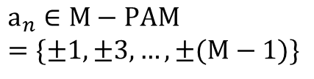



Precoding system and definition of SNR
TH precoding
$$2\text{M}×{\text{k}}_{n}$$
Info bits
Encoding and symbol mapping
$${\text{a}}_{n}$$
DAC, TX filter, Channel, RX filter, ADC
FF equalizer
Soft- demapping and decoding
Info bits
$$Σ$$
h(D)-1
$≅\text{h}\left(\text{D}\right)\text{=1+}{\text{h}}_{\text{1}}\text{D}\text{+}{\text{h}}_{\text{2}}{\text{D}}^{\text{2}}$…
$$σ_{w}^{2}$$
a(D)
$${\text{x}}_{n}$$
$$\text{y}\left(\text{D}\right)\text{=}\text{a}\left(\text{D}\right)\text{+2}\text{Mk}\left(\text{D}\right)\text{+}\text{w}\text{(}\text{D}\text{)}$$
$${\text{a}}_{n}∈M−PAM \\ =\{±1,±3,…,±(\text{M}−1)\}$$
$$\text{x}\left(\text{D}\right)=\frac{\text{a}\left(\text{D}\right)\text{+2}\text{Mk}\text{(}\text{D}\text{)}}{\text{h}\text{(}\text{D}\text{)}}$$
$$\text{−}\text{M}\text{≤}{\text{x}}_{\text{n}}\text{<}\text{M}\text{: }{\text{E}}_{\text{x}}\text{=}{\left(\text{2}\text{M}\right)}^{\text{2}}\text{/12}$$
$$SNR≡{E_{x}}/{σ_{w}^{2}}$$

Slide 4
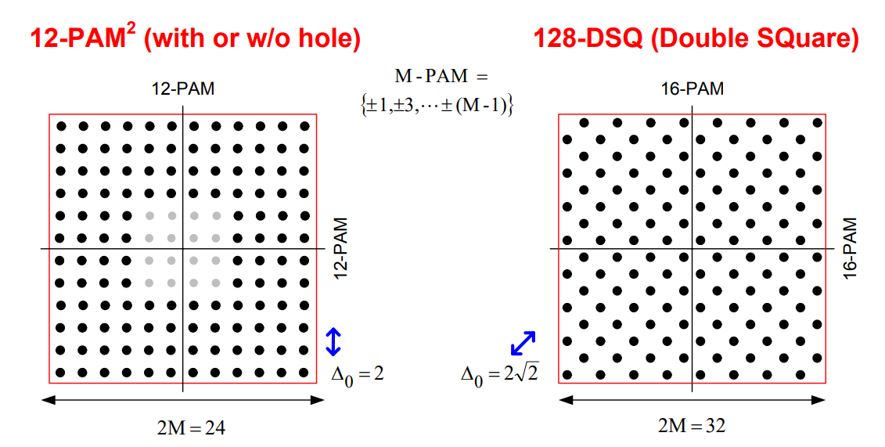


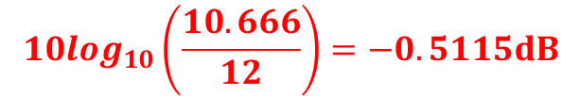

2-D constellations for modulation rates in 800+ Mb range
$${E_{x}}/{∆_{0}^{2}=\frac{{24}^{2}}{12×4}=12}$$
$${\text{E}}_{\text{x}}\text{=}{\left(\text{2}\text{M}\right)}^{\text{2}}\text{/12}$$
$${E_{x}}/{∆_{0}^{2}=\frac{{32}^{2}}{12×8}=10.666}$$
$$10\log_{10}\left(\frac{10.666}{12}\right)=−0.5115dB$$

Slide 5
Coding, modulation, framing: two variants

Slide 6
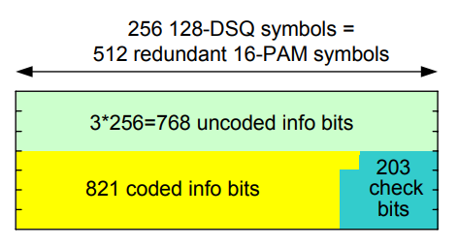
Coding, modulation, framing: variant I
128DSQ and (1024,821)LDPC coding
Code rate: 3.1035 bit/dim
Framing example
XGMII
2 x (32 TXD+ 4 TXC) bits
10GBASE-T Frame
8 code blocks over 4 pairs = 8 x 1589 bits
=195 x 65-bit blocks+37 overhead bits (0.29%)
64+/65
Trans-coding
Framing
+
Coding
+
Modulation
65-bit blocks
TX_CLK:
10 GHz/64 = 156.25MHz
10 GHz/64
= 156.25MHz
Modulation rate:
10 GHz/64 x 1024/195
= 820.51Mbaud (Symbol/unit time)

Slide 7
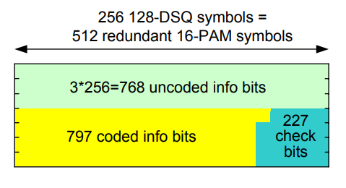
Coding, modulation, framing: variant II
128DSQ and (1024,797)LDPC coding
Code rate: 3.0566 bit/dim
-0.0469 bit/dim vs. 0.28 dB gain
Framing example
XGMII
2 x (32 TXD+ 4 TXC) bits
10GBASE-T Frame
1 code blocks over 4 pairs = 1565 bits
=24 x 65-bit blocks+5 overhead bits (0.28%)
64+/65
Trans-coding
Framing
+
Coding
+
Modulation
65-bit blocks
TX_CLK:
10 GHz/64 = 156.25MHz
10 GHz/64
= 156.25MHz
Modulation rate:
10 GHz/64 x 128/24
= 833.33Mbaud (Symbol/unit time)

Slide 8
128-DSQ mapping

Slide 9
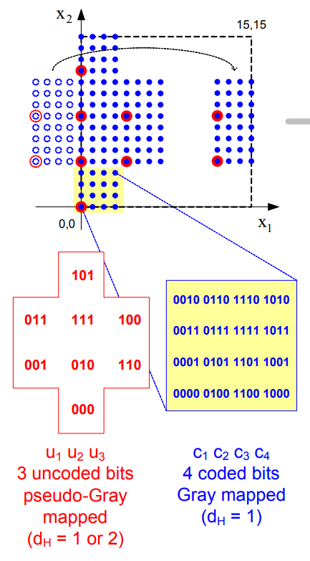
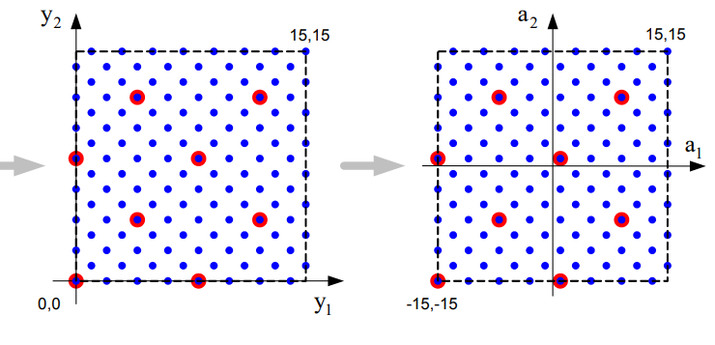
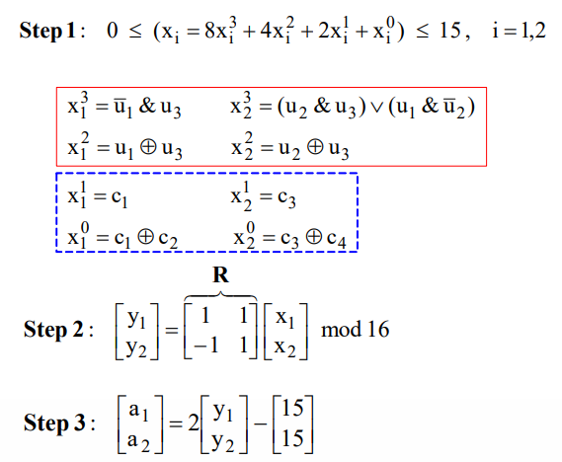

Slide 10
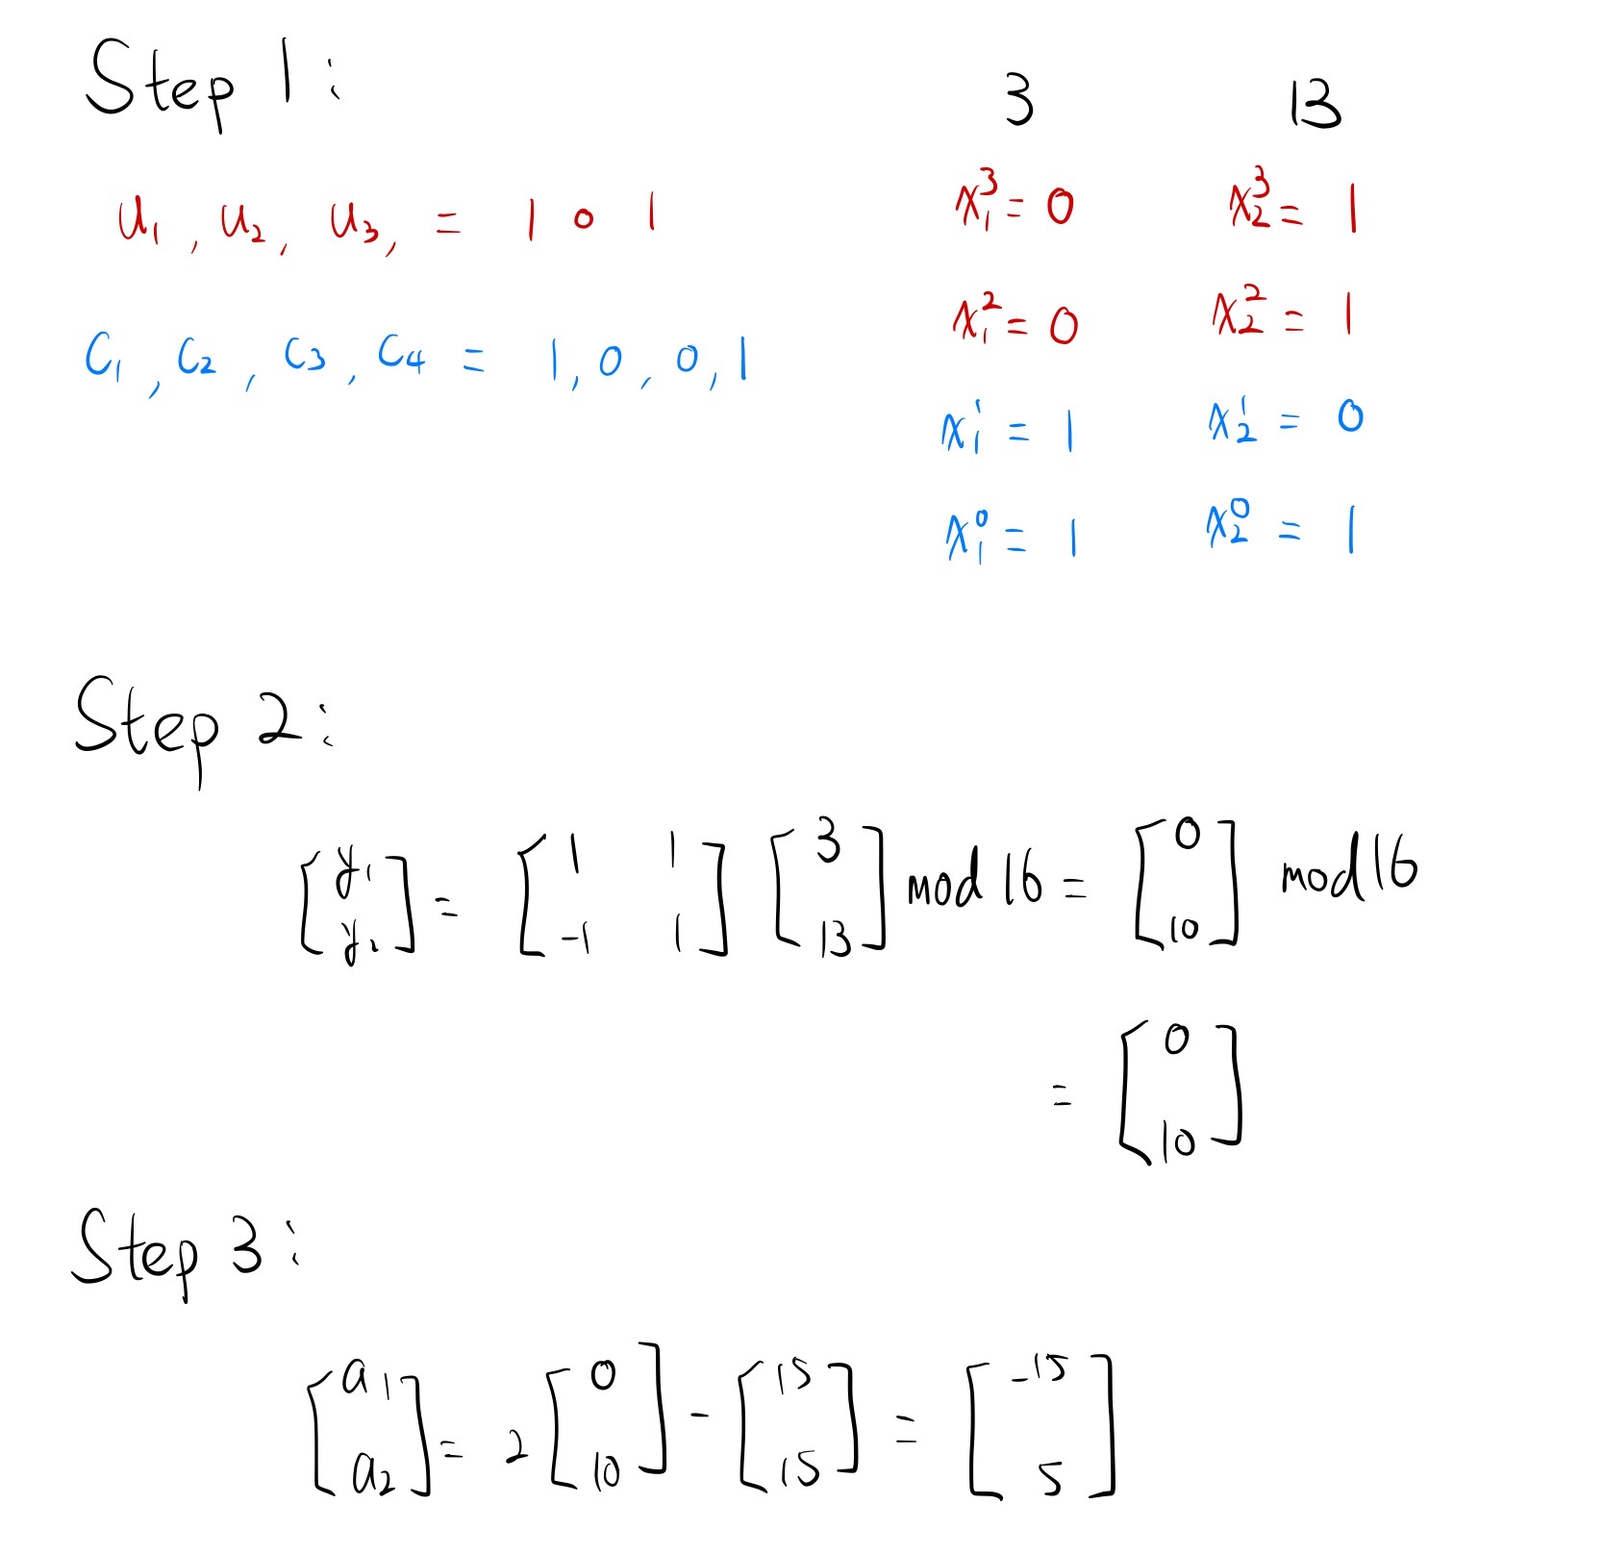
128-DSQ mapping example:

Slide 11
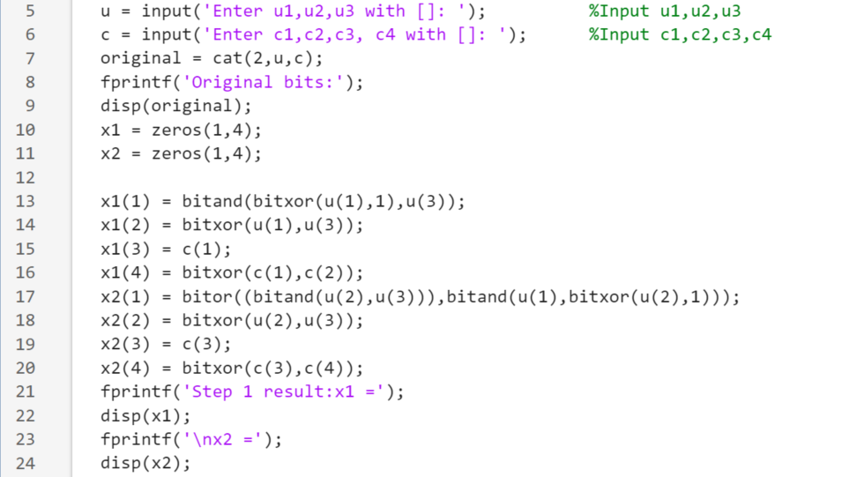
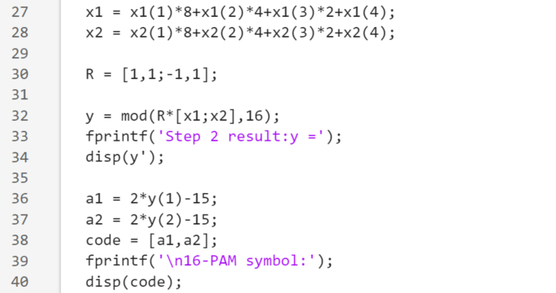
Matlab simulation of 128-DSQ mapping

Slide 12
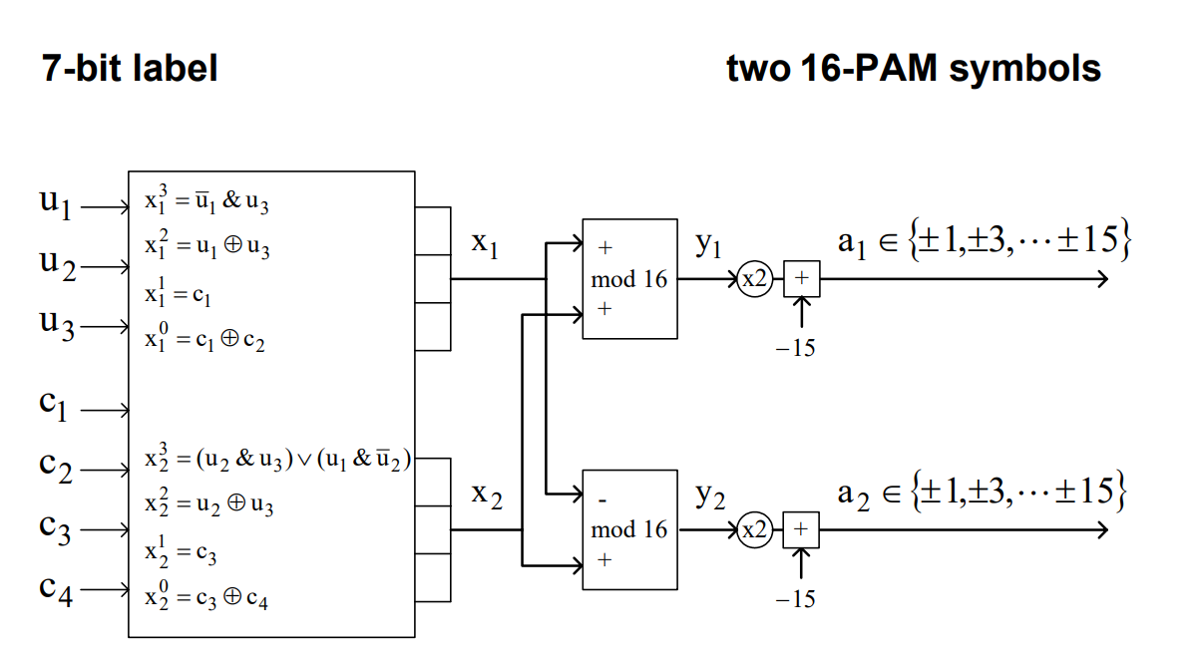
128-DSQ bit mapping: implementation

Slide 13
128-DSQ soft-demapping

Slide 14
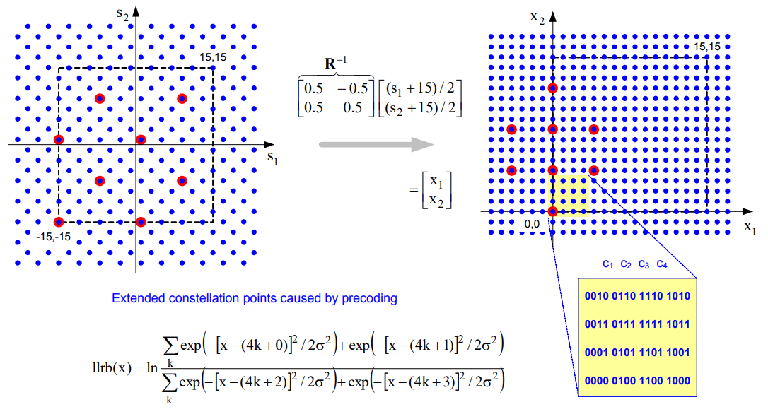
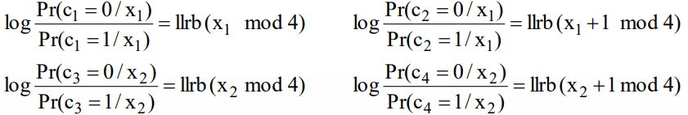
128-DSQ soft demapping: 4 coded bits

Slide 15
The function llrb(x)
Log-likelihood ratio
Complex AWGN channel

Slide 16
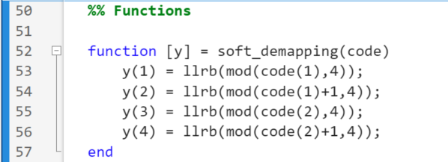
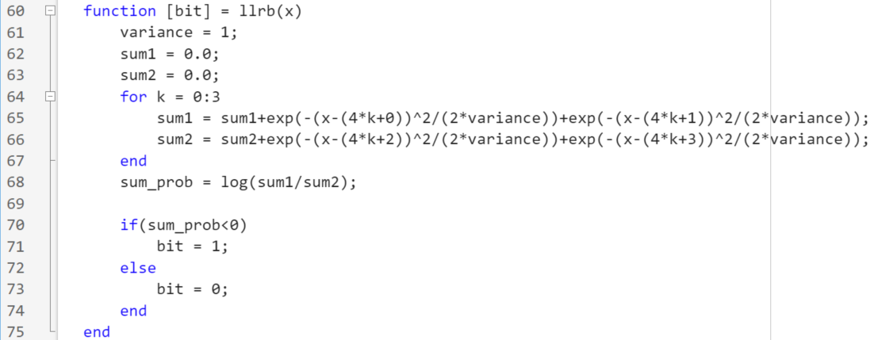
Matlab simulation of function llrb(x)

Slide 17
Performance Result

Slide 18
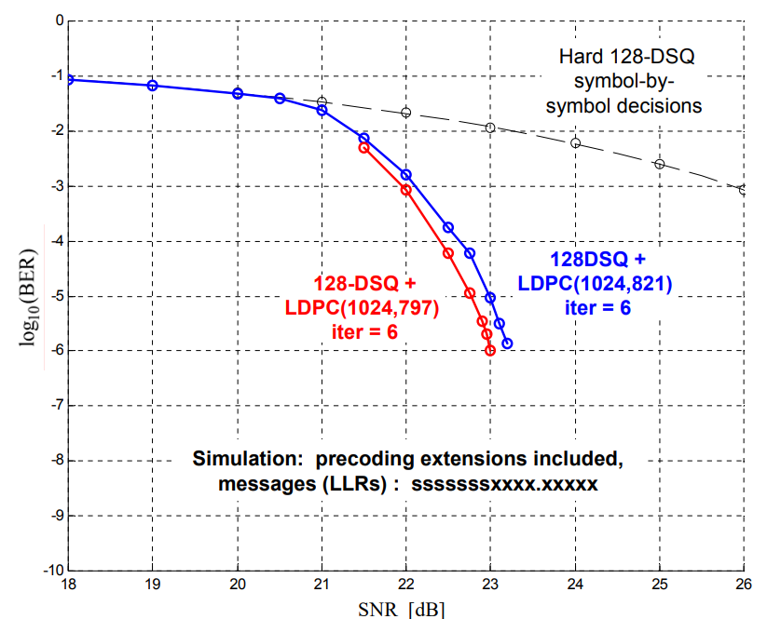
128-DSQ + LDPC performance

Slide 19
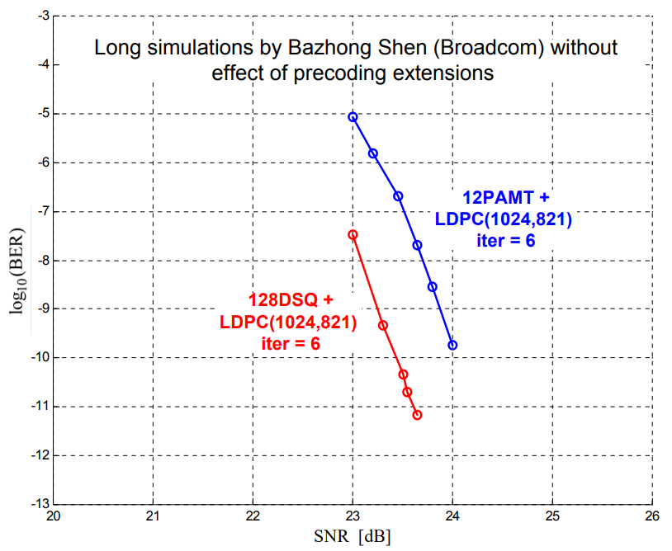
12-PAM-T and 128-DSQ + LDPC performance

Slide 20
Conclusions
Bit mapping, precoding, metric calculation, subset decoding: all based on simple logic and power-of-two based arithmetic
Stronger LDPC(1024,797) code is better matched to uncoded-bit-only error performance
Simple low-overhead framing and easy clock generation

Slide 21
Citations
10GBASE-T Coding and Modulation: 128-DSQ + LDPC: https://www.ieee802.org/3/an/public/sep04/ungerboeck_2_0904.pdf
LDPC (Low Density Parity Check) coded 128 DSQ (Double Square QAM) constellation modulation and associated labeling: https://patents.google.com/patent/US20060045197

Slide 22
Matlab codes

